Slide 1
What is Wellness?
Herbal Gardens Wellness, 501c3 NPO Community Healthcare Education

Slide 2
Please take out a favorite pen, journal or sheet of paper.
Follow along with the slides. Sketch, doodle, write out your ideas and thoughts.

Slide 3
Wellness
Wellness is…
I feel well when…
Wellness, schmellness…
unicorn
To me wellness means…
How do you define wellness?

Slide 4
How can we experience Wellness?
What does experience mean to you?
Word Art an experience that makes you think of Wellness.

Slide 5
Write out 5 Wellness Experiences that will nourish your Spirit
Is Wellness a static state?
Is Wellness physical, mental, emotional, or spiritual?
Is Wellness fluid?
Take a moment and take a deep breath. Relax your shoulders, and exhale. Repeat three times.

Slide 6
Identify your top three stressors. Write these down, in black ink, and then take your colorful pens and doodle positive words to counteract them.
Top Causes of Stress in the U.S. Factors
1
Job Pressure: Co-Worker Tension, Bosses, Work Overload
2
Money: Loss of Job, Reduced Retirement, Medical Expenses
3
Health: Health Crisis, Terminal or Chronic Illness
4
Relationships: Divorce, Death of Spouse, Arguments with Friends, Loneliness
5
Poor Nutrition: Inadequate Nutrition, Caffeine, Processed Foods, Refined Sugars
6
Media Overload: Television, Radio, Internet, E-Mail, Social Networking
7
Sleep Deprivation: Inability to release adrenaline and other stress hormones

Slide 7
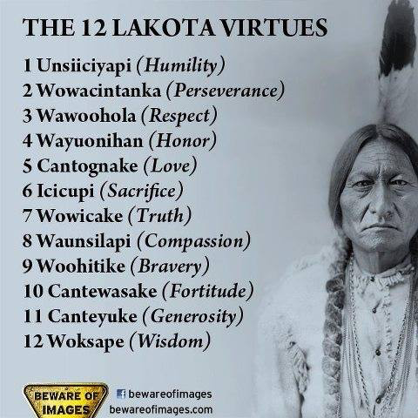
Balance in life comes from harmony with virtues. These are from the internal guidance that connect us to each human and living beings. We call this peace.

Slide 8
Wellness Definition
"Wellness is a process of becoming aware of and making choices toward a more successful existence". NWI

Slide 9
When balance is present a flow, or fluid good feeling carries us.
Write your own wellness statement.

Slide 10
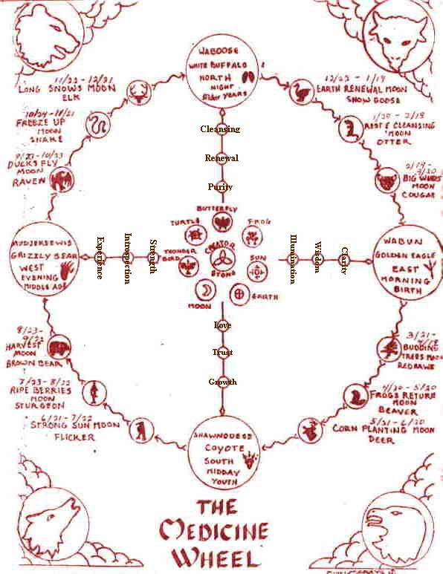
Wellness is a sense of connectivity to all living beings around us.
"The land is sacred. These words are at the core of your being. The land is our mother, the rivers our blood. Take our land away and we die. That is, the Indian in us dies." - Mary Brave Bird, Lakota

Slide 11
"We learned to be patient observers like the owl. We learned cleverness from the crow, and courage from the jay, who will attack an owl ten times its size to drive it off its territory. But above all of them ranked the chickadee because of its indomitable spirit." - Tom Brown, Jr., The Tracker

Slide 12
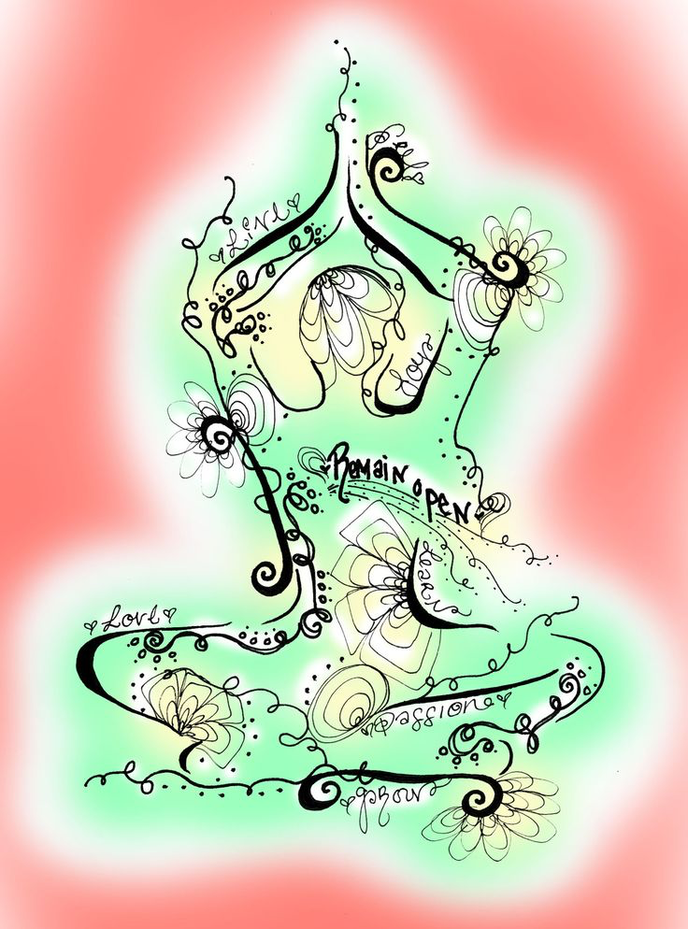
Inter -Connectedness
What does this look like to you?
Sign your name in the center of the page.
Sketch, doodle, write, attach photos of every living being you love.

Slide 13
" Health is more than the absence of dis-ease. Health is a state of optimal wellbeing."
WHO-World Health Organization

Slide 14
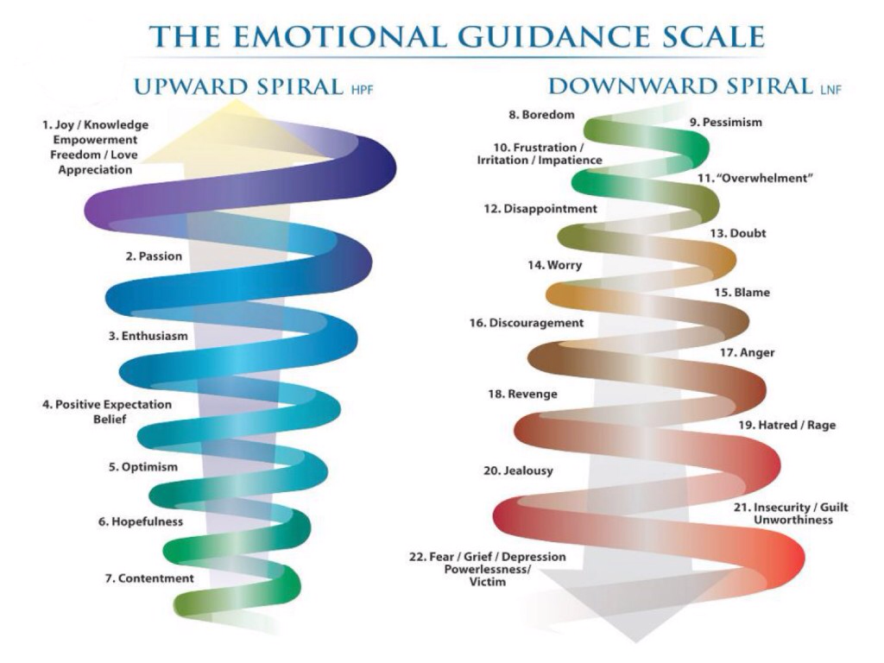

Slide 15
Thank you!
https://www.facebook.com/HerbalGardensWellness/?ref=bookmarks

