Slide 1
5 factors of Stress & overcoming stress through positive Actions
Herbal Gardens Wellness, NPO
Community Health Education

Slide 2
5 factors of stress
Overcoming Stress begins in BONDING/COMMUNITY
Stress Response begins immediately with these 5 Factors of Stress.
Worry (The same stress repeats over and over again.)
Isolation
Lack of Control in Life Decision
Control of Choices by External Energy
Perception of Probable Improvements
Outlets for Frustration: Transition Energy (Negative to Positive)
Exercise
Dance
Singing
Helping Others
Praying (Gratitude)
Ceremony
Food Sharing
Nature

Slide 3
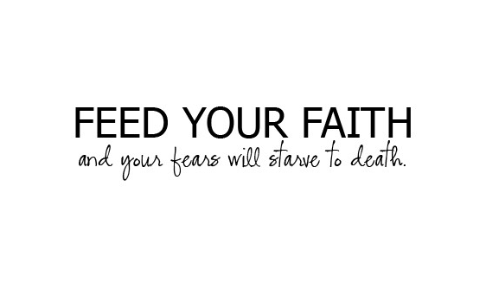
Taking each step in Gratitude (Prayer)
Eliminates WORRY

Slide 4
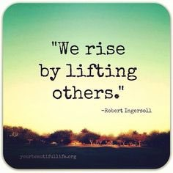
Ceremony (Isolation)
Bonding Eliminates Loneliness
Give Love, Live the Message

Slide 5
Volunteer Work
Oxytocin (Bonding) and Serotonin (Joy) increases in a human being when they take an action. This includes the choice to donate their time, our most precious resource, to others to listen, work side by side, or to provide support of other resources.
Overcomes Lack of Control in Life Decision

Slide 6
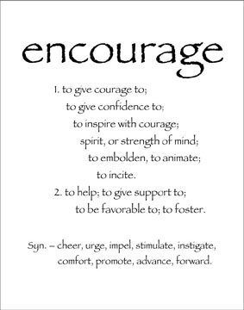
Empowerment
When we can encourage ourselves through acknowledging our purpose to help others we create positive hormone sequences in ourselves and others around us. We set an example of leadership and beauty. We provide a path to journey together.
The beginning of all good comes from the spirit that we are indeed capable of our own power to change and become the Creator of Good on the Earth.
Creates Control of Choices by External INTERNAL Energy

Slide 7
Positive Thoughts (Perception of Probable Improvements)
Empowerment

Slide 8
Transition Skills are taught through ceremony
Acknowledge
Connection
Eat Plant Foods
Pray
LOVE Greatly

Slide 9
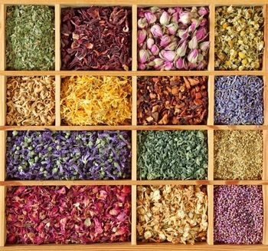
Brought to you by…..

